Slide 1
DEEP LEARNING APPLICATIONS IN MEDICAL IMAGE ANALYSIS
Sreelakshmi Prasanth
Roll No:60
S7,ComputerScience
MACE,Kothamangalam
24th October 2018

Slide 2
CONTENTS
Deep Learning Applications in Medical Image Analysis
Electronic Health Record
Existing Method
Proposed Method
Artificial Neural Network in medicine
Machine Learning Architectures
Convolutional Neural Network
Layers of CNN
Unsupervised Learning Models
Applications

Slide 3
EHR
Deep Learning Applications in Medical Image Analysis
An electronic health record (EHR) contains patient health information
Information includes Digital medical images
Different modalities of digital medical imaging
- Ultrasound(US)
- X-ray
-Computed Tomography(CT) Scans
- Magnetic-Resonance imaging(MRI)

Slide 4
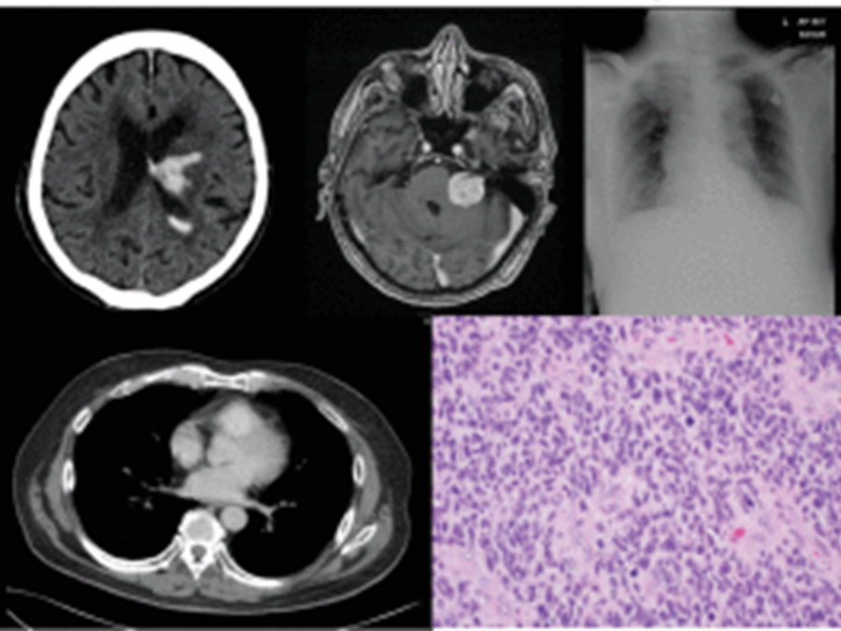
Deep Learning Applications in Medical Image Analysis
EHR(contd..)
FIGURE . A collage of images depicting medical images
https://www.google.co.in/search?q=electronic+health+records&source=lnms&tbm=isch&sa=X&ved=0ahUKEwjBzOnV6PrdAhUDVH0KHRLAAPUQ_AUIDygC

Slide 5
Deep Learning Applications in Medical Image Analysis
EXISTING METHOD
Currently analysed by radiologists
Years and Financial cost
Delays or erroneous diagnosis
Not accurate

Slide 6
PROPOSED METHOD
Deep Learning Applications in Medical Image Analysis
Application of Machine Learning Algorithm
Artificial Neural Network
Machine Learning Techniques

Slide 7
Deep Learning Applications in Medical Image Analysis
Artificial Neural Network
Information processing paradigm
Highly inter-connected processing elements
ANN,like people,learn by example
Cannot be programmed to perform a task

Slide 8
Artificial Neural Network in Medicine
Deep Learning Applications in Medical Image Analysis
Neural Network learn by example
A set of examples are needed
Examples need to be selected carefully
Disadvantage : Unpredictable operation

Slide 9
Machine learning Architectures
Deep Learning Applications in Medical Image Analysis
Supervised Learning Models
Labelled training data
Set of training examples
An input object and a desired output value

Slide 10
Deep Learning Applications in Medical Image Analysis
Machine Learning Architectures
Unsupervised Learning Models
To find the patterns in data
The data given are not labelled
Only the input variables(X) are given

Slide 11
Convolutional Neural Networks
Deep Learning Applications in Medical Image Analysis
Most popular algorithm in image recognition
Unique characteristics
Spatial relationships
Example

Slide 12
Deep Learning Applications in Medical Image Analysis
Convolutional Neural Networks
Layers of CNN
Convolutional Layer
Rectified Linear Unit Layer
Pooling Layer
Fully Connected Layer

Slide 13
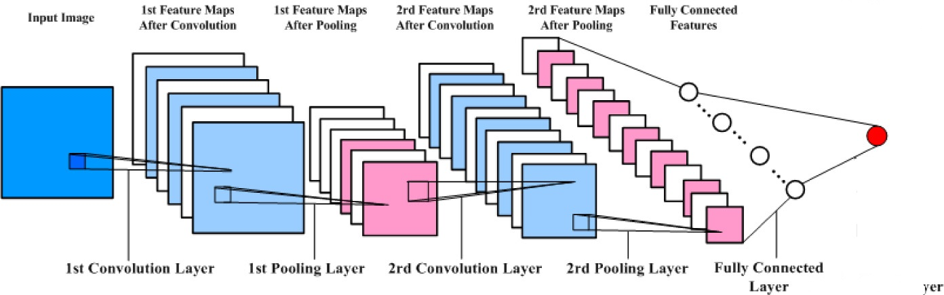
Convolutional Neural Networks
Deep Learning Applications in Medical Image Analysis
Courtesy:https://www.google.co.in/search?q=convolutional+neural+network&source=lnms&tbm=isch&sa=X&ved=0ahUKEwi0nsaa5PrdAhXWfn0KHZ6SDHIQ_AUIDigB&biw=1366&bih=657

Slide 14
Convolutional Layer
Deep Learning Applications in Medical Image Analysis
Convolution Operation
One function is a pixel value
Second one is filter
Dot product between two functions
Feature map or Activation map

Slide 15
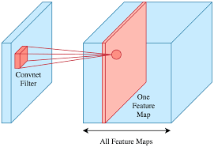
Convolutional Layer(contd..)
Deep Learning Applications in Medical Image Analysis
Courtesy:https://www.google.co.in/search?q=convolutional+layer&oq=convolutional+layer&aqs=chrome..69i57j69i60j0l4.6861j0j7&sourceid=chrome&ie=UTF-8

Slide 16
Convolutional Layer(contd..)
Deep Learning Applications in Medical Image Analysis
The convolution operation
An output (or feature map) s(t) is defined
Input I(t) is convolved with a filter or kernel K
s(t) = (I ∗ K)(t)

Slide 17
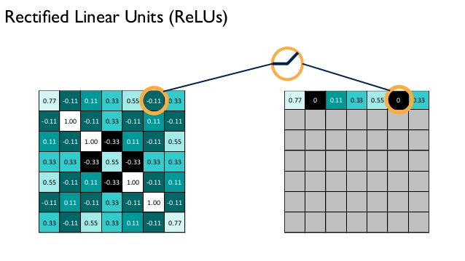
Rectified Linear Unit Layer(RELU)
Deep Learning Applications in Medical Image Analysis
Courtesy:https://www.google.co.in/search?q=rectifiedlinear+unit+layer&oq=rectifiedlinear+unit+layer&aqs=chrome..69i57j0.12657j0j7&sourceid=chrome&ie=UTF-8

Slide 18
Pooling Layer
Deep Learning Applications in Medical Image Analysis
Inserted between Convolutional and RELU
Max-pooling is most commonly used
Stride length
Larger stride

Slide 19
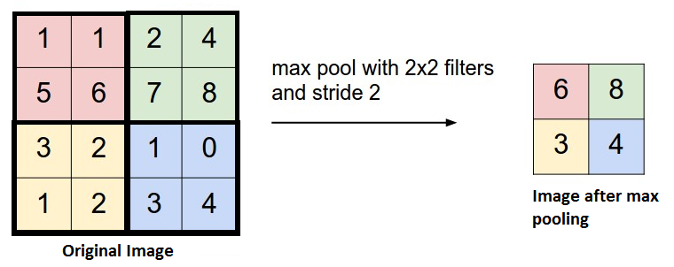
Pooling Layer(contd..)
Deep Learning Applications in Medical Image Analysis
Courtesy:https://www.google.co.in/search?q=poolinglayer&source=lnms&tbm=isch&sa=X&ved=0ahUKEwi2j6Ph5frdAhVSU30KHblDAl8Q_AUIECgD&biw=1366&bih=657

Slide 20
Pooling Layer(contd..)
Deep Learning Applications in Medical Image Analysis
Reduces the spatial dimension of the feature map
Reduces the number of parameters
This simplifies the overall model complexity
Reduce the computational cost
Make the network more generic

Slide 21
Fully Connected Layer
Deep Learning Applications in Medical Image Analysis
It uses softmax activation function
Compute a probability score for classification
It is based on training dataset
Example

Slide 22
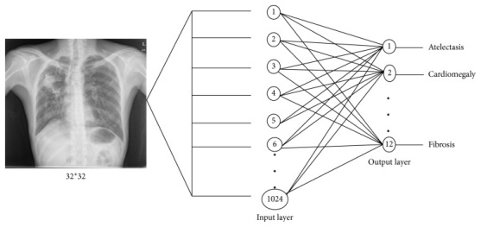
Fully Connected Layer(contd..)
Deep Learning Applications in Medical Image Analysis
Courtesy:https://www.google.co.in/search?q=fully+connected+layer&source=lnms&tbm=isch&sa=X&ved=0ahUKEwiMscK75vrdAhXDfisKHQ7KAdYQ_AUIDigB&biw=1366&bih=657

Slide 23
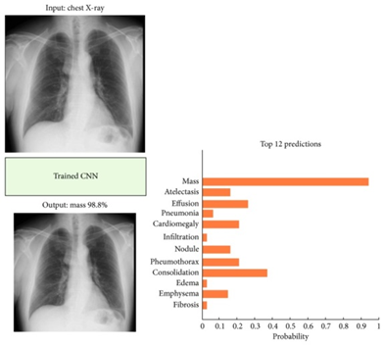
Deep Learning Applications in Medical Image Analysis
Fully Connected Layer(contd..)
Courtesy:https://www.google.co.in/search?q=fully+connected+layer&oq=fully&aqs=chrome.1.0l2j69i59j35i39j0l2.3837j0j7&sourceid=chrome&ie=UTF-8

Slide 24
Unsupervised Learning Models
Deep Learning Applications in Medical Image Analysis
Autoencoders
Feature detectors
Learn codings in an unsupervised manner
Reduce model dimensionality and complexity
Generate new data similar to input training data
Unique architectural feature

Slide 25
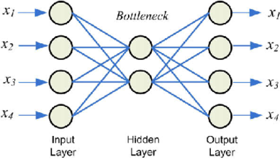
Deep Learning Applications in Medical Image Analysis
Denoising Autoencoders
Sparse Autoencoders
Autoencoders
Courtesy:https://www.google.co.in/search?q=autoencoders&source=lnms&tbm=isch&sa=X&ved=0ahUKEwj8y-6R5_rdAhVOU30KHZTpC9sQ_AUIDygC&biw=1366&bih=657

Slide 26
Restricted Boltzmann Machines
Deep Learning Applications in Medical Image Analysis
Useful for dimensionality reduction and classification
RBMs are shallow, two-layer neural nets
Visible or input layer and hidden layer
There is no intra-layer communication
RBM machines can be used in deep belief networks.

Slide 27
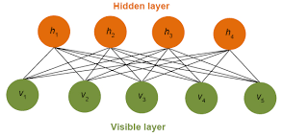
Restricted Boltzmann Machines(contd..)
Deep Learning Applications in Medical Image Analysis
Courtesy:https://www.google.co.in/search?q=restricted+boltzmann+machine&oq=restricted+boltzmann+machine+&aqs=chrome..69i57j69i59l2j69i60l2j0.17716j0j7&sourceid=chrome&ie=UTF-8

Slide 28
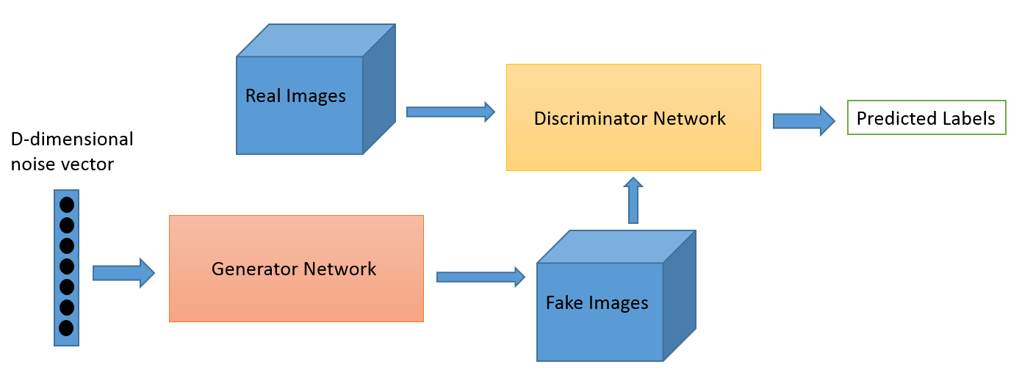
Generative Adversarial Networks
Deep Learning Applications in Medical Image Analysis
Courtesy:https://www.google.co.in/search?q=general+adversarial+networks&oq=general+adversi&aqs=chrome.1.69i57j0l5.8470j0j7&sourceid=chrome&ie=UTF-8

Slide 29
Applications
Deep Learning Applications in Medical Image Analysis
1)Image Detection
Organ detection from a given complex dataset
To detect Cerebral Microbleeds (CMBs) from MRI Images
2)Image Registration
Superimposing two or more images
Display their information in the same image
Limitation

Slide 30
Applications(contd..)
Deep Learning Applications in Medical Image Analysis
3)Image Segmentation
Examples
Segmentation of GM, WM, and CSP
Multimodal Brain Tumor Image Segmentation
MR Brain Image Segmentation
Cardiac MR Left Ventricle (LV) segmentation

Slide 31
Conclusion
Deep Learning Applications in Medical Image Analysis
Challenges
Lack of labelled datasets
Public reception
Future Applications
Content-based image retrieval
Image report or Caption Generation

Slide 32
Deep Learning Applications in Medical Image Analysis
REFERENCES
[1] C.-J. Hsiao, E. Hing, and J. Ashman, ‘‘Trends in electronic health record system use among office-based physicians: United states, 2007–2012,’’ Nat. Health Stat. Rep., vol. 75, pp. 1–18, May 2014.
[2] R. Smith-Bindman et al., ‘‘Use of diagnostic imaging studies and associated radiation exposure for patients enrolled in large integrated health care systems, 1996–2010,’’ JAMA, vol. 307, no. 22, pp. 2400–2409, 2012.
[3] E. H. Shortliffe, Computer-Based Medical Consultations: MYCIN, vol. 2. New York, NY, USA: Elsevier, 1976.

Slide 33
Deep Learning Applications in Medical Image Analysis
[4] G. Litjens et al. (Jun. 2017). ‘‘A survey on deep learning in medical image analysis.’’ [Online]. Available: https://arxiv.org/abs/1702.05747
[5] W. S. McCulloch and W. Pitts, ‘‘A logical calculus of the ideas immanent in nervous activity,’’ Bull. Math. Biol., vol. 5, nos. 4, pp. 115–133, 1943.
[6] F. Rosenblatt, ‘‘The perceptron: A probabilistic model for information storage and organization in the brain,’’ Psychol. Rev., vol. 65, no. 6, pp. 365–386, 1958.

Slide 34
THANK YOU

